Slide 1
DEVELOPMENT
ICT4D
WEEK 2
Dimensions, Approaches, Alternative Perspectives

Slide 2
Let us pick up the thread
Development is highly contested concept having wide ranges of meanings and connotations
In common parlance, it denotes a process of growth and progression towards betterment; a positive growth which is considered qualitatively good
It is a value judgemental concept, highly political and linked to power structure in society
Development as a discourse denotes various meanings getting assigned to the word development through narratives, speech, communication, language.
Development: what, for whom, and how? Changing the referent point changes the meaning of development.
The contemporary development discourse has its origin in post world war II foreign policies of USA/’West’ aimed towards development and modernization of the 3rd world countries.

Slide 3
What are intended to be covered?
Dimensions of development
Approaches to development
Alternative meanings and models of development

Slide 4
Discourse of Development: Genealogy
In ancient period, philosophers considered human progress cyclical
Aristotle- virtuous conditions degenerate over time, then regenerate
Enlightenment period( 18th century Europe)- progress in human civilization linear, may be continuous with scientific evolution- liberal conception of development
Hegel: Continuous Progress in human civilization through development of ideas- thesis-antithesis- synthesis
Marx: development is continuous progression in mode of production through class struggle
1949: Truman's famous address gave contemporary discourse of development
Developed vs underdeveloped
Development as faster production, and material well-being by scientific, technocratic methods by experts and by employing capital
Development is Modernization
Universal concept, mechanisms across all socio-cultural contexts

Slide 5
Development and Modernisation theory
During 1950s-70s, the Western World led by USA created the discourse of Development and modernization
'Developmentalism’ - conceptual paradigm
there is a fixed path of development & modernization as traversed by western nations; by following the same path, poor 3rd world nations would also become developed.
Development:
Rapid industrialization, free trade, leverage market, fast GDP growth, economic prosperity, material comforts, etc.
Modernization:
Liberal Democracy, modern institutions, modern education, health, transport, communication system; modern political values- Liberty, Rights, Equality, pluralism, secularism, reason/rationality, scientific temper, individual autonomy, etc.
In western discourse development is universal, objective, scientific, technocratic, progressive, and politically neutral

Slide 6
Challenges to Developmentalism : Dependency Theory
Dependency theory criticized the dominant model of development as ‘Eurocentric’, furthering the capitalist interests of the ‘West’.
Challenged the Western discourse of development; In this view ideology, interest, and politics permeate the discourse of development
Core vs Periphery
Global economic system- core- developed nations of ‘West’; periphery: poor nations of 3rd world
Metropolitan vs satellite
Developed region of poor 3rd world nations act as satellite of Metropolitan centers in West
Metro- satellite pattern in underdeveloped nation
‘Development of Underdevelopment’
Notes:
development of the West had come on the shoulders and at the cost of the non- West.

Slide 7
Dimensions of Development

Slide 8
Dimensions of development
Economic
Social
Cultural
Political
Environmental
Human

Slide 9
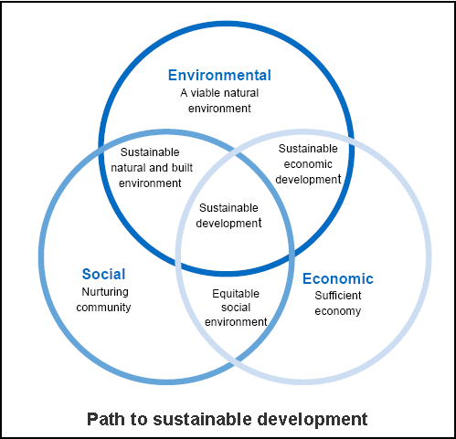
All the dimensions of development are interconnected

Slide 10
Economic Dimension of development
Mainstream discourse on development
Faster growth of GDP, robust infrastructure, industrialization, technological innovations, material comforts, modern life style
Main aim of the development and modernization theories
Development as apolitical, technocratic, and scientific concept
Universal aim, methods/mechanisms, processes, stages.
Linked to Liberal free market economic ideology and the Income approach to development

Slide 11
Social Dimension of development
Socio-political arrangements to facilitate fulfilled and flourished life of the individual
Nurturing communities
Social harmony, Social solidarity- we or community feeling
Social equity, social justice, socio-political freedom and rights
Less inequal, hierarchical, and oppressive social structures
Balance between individual rights and societal common Good
Notes:
Social Equity is the active commitment to fairness, justice, and equality in the formulation of public policy, distribution of public services, implementation of public policy

Slide 12
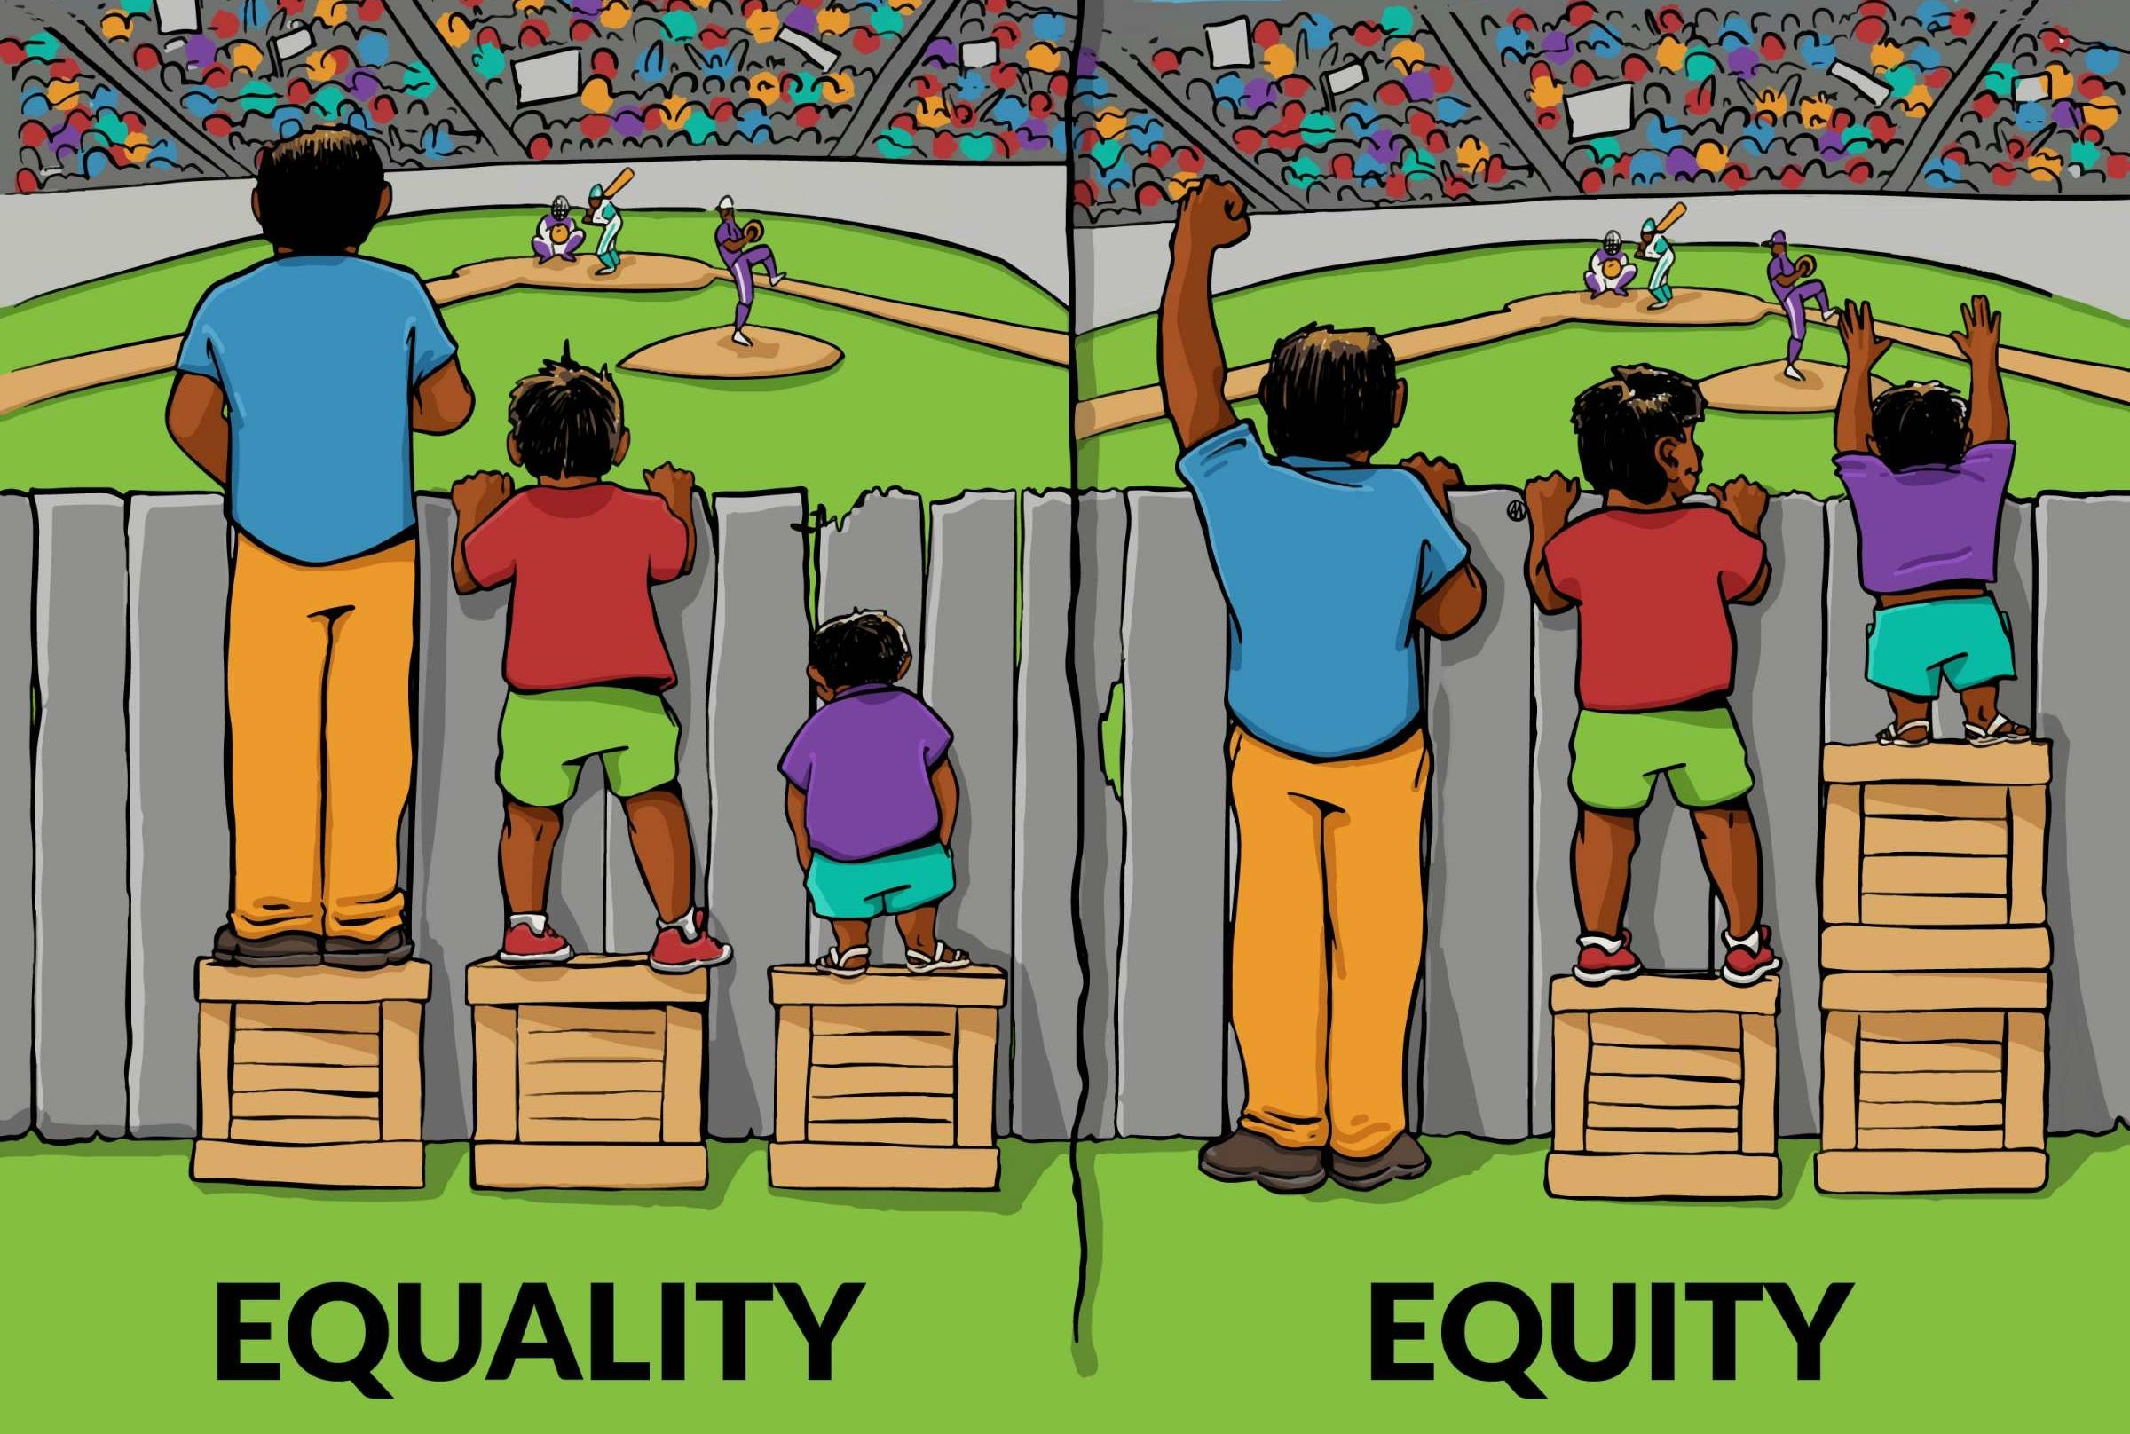

Slide 13
Cultural Dimension of development
Stable cultural structure providing meaningful choices to its members
Multiculturalism- unity in diversity
Toleration, pluralism, and recognition to minority cultures
Protecting Minority Rights, Rights of indigenous people
Providing group & cultural rights
Equality among cultures- both within a nation and at global level
Absence of cultural hegemony

Slide 14
Political Dimension of Development
Capacity of the political system to provide stable, efficient, and effective government to facilitate well being of the citizen
Efficient political institutions
Participative political culture, civic culture
Adopting Good Governance model
Political equality, freedom, and rights
Less divisive and more constructive political system

Slide 15
Environmental Dimension of development
Nurturing natural environment
Maintaining ecological balance, bio-diversity
Circular economic model
Using natural resources wisely
Inter-generational equity
Fulfilled & flourished human life in harmony with nature
Obeying natural laws, natural justice
Sustainable development

Slide 16
Human Development

Slide 17
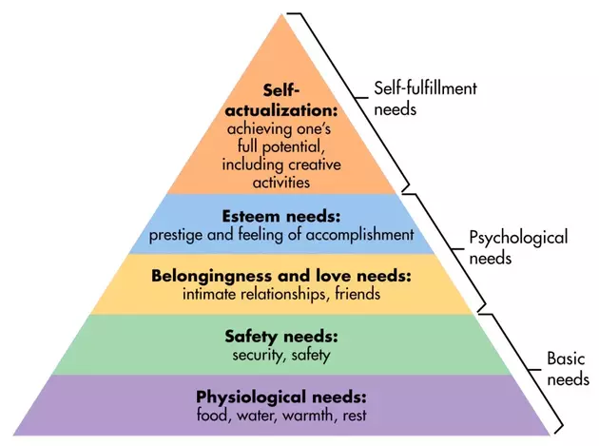
Psychological dimension : Maslow's hierarchy of needs
Theory of human developmental psychology
Once a lower level need is met, more or less, one start to feel higher level need
Human develops by rising on the need hierarchy
Flourished, fulfilled life is one which could meet the Self-actualization need

Slide 18
Human Development-1/3
Development is all about enlarging people’s choices in order to lead long, healthy lives with dignity (Dr Mahbub-ul-Haq)
Development is increasing freedom through social and political institutions and processes (Prof Amartya Sen)
Freedom is capabilities to do desired things and achieve well-being
Human Development:
Resources & capabilities to make choices to have meaningful life
Process of improving human life, making it more meaningful- human flourishment
By (as given by Economist Michael Todaro)
1. increase standard of living ;
2. Increasing range of choices- increase freedom;
3. Create conditions conducive to ensure self-esteem and dignity of individuals

Slide 19
Human Development-2/3
3 dimensions: access to resources, health, and education
4 Pillars: equity, sustainability, productivity and empowerment
4 Approach: Income approach; Minimum needs approach; Welfare approach; Capabilities approach

Slide 20
Human Development-3/3
Negative and Positive conceptions of human Development
Negative: modern, western, liberal conception
Equality of opportunity, Rights, Liberty, material resources, physical comforts/pleasure
Negative freedom, Negative Rights
Positive: ancient, normative, philosophical
Flourishment of human life, happiness, self-autonomy, self-realization, moral perfection
Positive freedom, positive rights
Human Development Index(HDI):
By UNDP, composite index between 0-1 to denote human Development in a country
Proxy indicators
Access to resources( living standard)- per capita GNP
Long and healthy life- life expectancy at birth
being knowledgeable- mean of years of schooling for adults aged 25 years and expected years of schooling for children of school entering age
India’s HDI is 0.645; 131 out of 189 countries
Notes:
does not reflect on inequalities, poverty, human security, empowerment

Slide 21
Limitations of HDI:
Measures attainments Not shortfall in human development
Human poverty index: The probability of not surviving till the age of 40, the adult illiteracy rate, the number of people who do not have access to clean water, the number of small children who are underweight, etc.
Does not say anything about the distribution
Ex: per capita GNP grew by 10 % but median per capita income reduced by 10%, persons below poverty line increased by 10 %, how?
Does not reflect on inequalities, poverty, human security, empowerment, and positive development

Slide 22
Approaches to Development

Slide 23
Approaches to Development
Income Approach
Welfare Approach
Rights Based Approach
Capability Approach
Sustainability Approach

Slide 24
Income Approach
Traditional Approach during 1950s and 60s
Based on the concept of the stages of economic growth- development was viewed as a series of successive stages through which all countries had to pass
A sustained increase in the GDP at rates more than 5 to 7 % per annum through saving, investment and foreign aid;
Structural changes in economy- share of agriculture(primary) declines, while the share of manufacturing( secondary) and the service (tertiary) sectors increases.
The objectives of poverty elimination, economic inequalities reduction and employment generation were mentioned but only as a passing reference.
trickle-down effect
Criticism: Neglecting the distributive justice
Supporting political ideology: Liberalism, Neo-liberalism

Slide 25
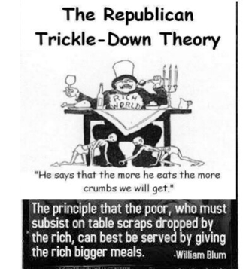
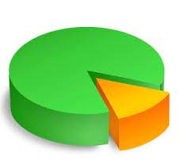
Make the Pie larger

Slide 26
Welfare Approach
Welfare: the health, happiness, and well-being of a person or group
By early 1970’s realization that Income approach had failed to improve the poverty and quality of life of masses
Direct policy measures towards eradication of poverty, providing more diversified employment opportunities, and reducing income inequalities
Notion of the Welfare State- provider of welfare products/services
Principles: Utilitarianism- greatest happiness of greatest number ; Social choice theory; Rawl’s theory of distributive Justice
Criticism: poor as objects of charity, passive recipient of welfare; populism
Supporting political ideology: Social Democracy, and socialism

Slide 27
Right based approach
Based on the concept of Human Rights
Human Rights: Basic rights(dignity, fairness, equality, respect and autonomy) available to each one as equal member to humanity
Development is protecting, ensuring, and expanding human Rights
Human Rights into development discourse
Universal Declaration of Human Rights (UDHR)- 1948;
World Conference on Human Rights in Vienna-1993
linking democracy, human rights, sustainability and development
Development: enabling people to demand their rights, and states to be able to fulfil their obligation to provide those rights.
Core themes: Universality and Inalienability, Equality and Non-Discrimination, Participation and Inclusion, Accountability and Rule of Law
Criticism: Undermine cultural relativism, driven by western values and agenda
Political ideology: Positive Liberalism

Slide 28
Capability Approach
Developed by Prof. Amartya Sen and Martha Nussbaum
Development is increasing functional capabilities (long life, education, engage in gainful economic transactions, participate in political activities);
assessing how well people are doing is their ability to live a life that we have reason to value, not their wealth of resources or subjective well-being
Development as freedoms; freedom- capabilities to engage in desired activities to achieve outcomes that are valuable
Poverty is understood as un-freedom or capability-deprivation
Core themes: Freedom of choices(to achieve well-being), well-being in terms of people’s capabilities and functioning
Notes:
freedom to achieve well-being is a matter of what people can do and be

Slide 29
Sustainability Approach
Based on the concept of sustainable development
Development which protect environment/ecology, uses natural resources judiciously, and does not jeopardize development for future generations
Mainstreaming the discourse of sustainable development
1970s: ‘Limits to Growth’, ‘Silent Spring’, Brundtland Commission Report- ‘Our Common Future’ ; ‘Tragedy of the Commons’; Rio Earth Summit-1992
UN SDGs-17 goals( 2015-30)- No Poverty, Zero Hunger, Good Health and Well-being, Quality Education, Gender Equality, Sanitation, Clean Energy, Decent Work and Economic Growth, etc.
Political Ideology: Green politics, Eco-feminism
Issues: Different perspectives of Developed and Developing Countries; Right to pollute; development vs ecology; common but differentiated responsibility

Slide 30
Alternate Conceptions of Development
Gandhian model
Marx’s model

Slide 31
Gandhian Notion of Development
Development is Freedom- Swaraj
For individual it denoted self-mastery, self-control, self-restrain, self-realization, moral goodness & perfectibility
For Community it meant self-governing autonomous community life without any formal coercive authority; full rights of civil liberties, and civil disobedience against any unjust actions/law of the state/govt
For political economy it denoted classless economic order, equal honour/dignity for all kinds of labour, self-renunciation( limiting our wants), Trusteeship, Sarvodaya( welfare of all), and Antyodya ( care for the last one)
It also meant freedom from want, material possession, ego, bondage of so called modern materialistic life- modern large machine, faster transport system, competition/conflict-court/lawyer, modern medical system-doctors, etc.
In sum, it was his vision of an ideal civilisation based on Non-violence (अहिंसा), Truth, and moral duty (Dharma) in contrast to western modern civilisation based on violence/force, material possession, and Rights

Slide 32
Development as Freedom- Prof Amartya Sen
Development to Prof Sen should be seen as a process of expanding the real freedoms that people enjoy and which make them capable to lead the kind of lives they have reason to value.
Narrower views of development: growth of gross national product, rise in personal incomes, industrialization, technological advance, social modernization
Increasing substantive Freedom and Human Capabilities should be the end/goal of development; Freedom ( free agency) is also means of development
Truly Free & capable people can effectively shape their own destiny and help each other.
They won’t remain poor; neither they will be passive recipient of welfare goods/services

Slide 33
5 Freedoms
Political Freedoms
Freedom to vote, fight election, political participation
Economic Facilities
Freedom to enter into market: trade/commerce/contract, Employment, access to resources
Social opportunities
Proper education, health care, social recognition, social equality & equity
Transparency guarantees
Transparent & open governance system
Protective Security
Social Security- unemployment allowances; old age care, pension, etc.
These freedoms are inter-linked and strengthens each other.
Economic unfreedom can breed social unfreedom, just as social or political unfreedom can also foster economic unfreedom.

Slide 34
Marxian concept of Development
Development is historical evolution in mode of production through class struggle
Primitive subsistence society--→master-slave society--→ Feudal Society( lord-serf)--→ Capitalist society( capitalist-labourer)--→ Socialist society ( Dictatorship of Proletariats') --→ Communist Society
Communist Society- Final stage of development
Classless, stateless society
Development is freedom
True freedom is social production in which each individual contribute freely as per his ability, and get as per one’s need and relate to fellow man as equal
Human development is Man working to realise essence of being human, act of self-realization
“it will be possible for me to do one thing today and another tomorrow, to hunt in the morning, fish in the afternoon, rear cattle in the evening, criticize after dinner, doing just that which gives me pleasure without ever becoming a hunter, fisherman, shepherd or critic. This will be the real state of freedom for man from alienation and exploitation”(Marx)

Slide 35
THANKS FOR LISTENING!
BE SAFE …GOOD WISHES !

